Slide 1

CS 533 INTRO TO DATA SCIENCE
Michael Ekstrand

Slide 2
STATISTICS AND DIFFERENCES

Slide 3

Learning Outcomes
Review statistics (or metrics)
Compute absolute and relative differences
Interpret a relative difference
Photo by Franck V. on Unsplash

Slide 4
Statistics
We compute various statistics
Mean
Median
Max
Success rate
90 %ile
Count
Sum
Many others…
Often serve as metric for analysis or evaluation

Slide 5
Comparing Values
Take two values: population (2018 est.) of
Boise: 228,790
Salt Lake City: 200,591
Can compare in two ways:
Absolute – Boise has 28K more people than SLC
Relative – Boise has 14.05% more people than SLC

Slide 6
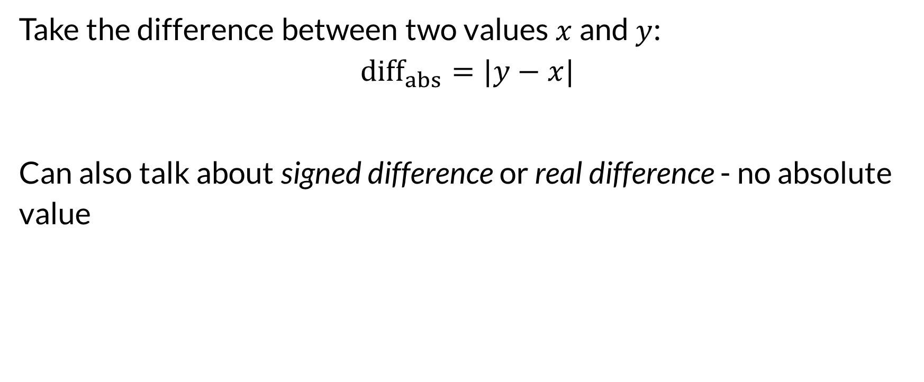
Absolute Comparison
Take the difference between two values $x$ and $y$:
$${diff}_{abs}=|y−x|$$
Can also talk about signed difference or real difference - no absolute value

Slide 7
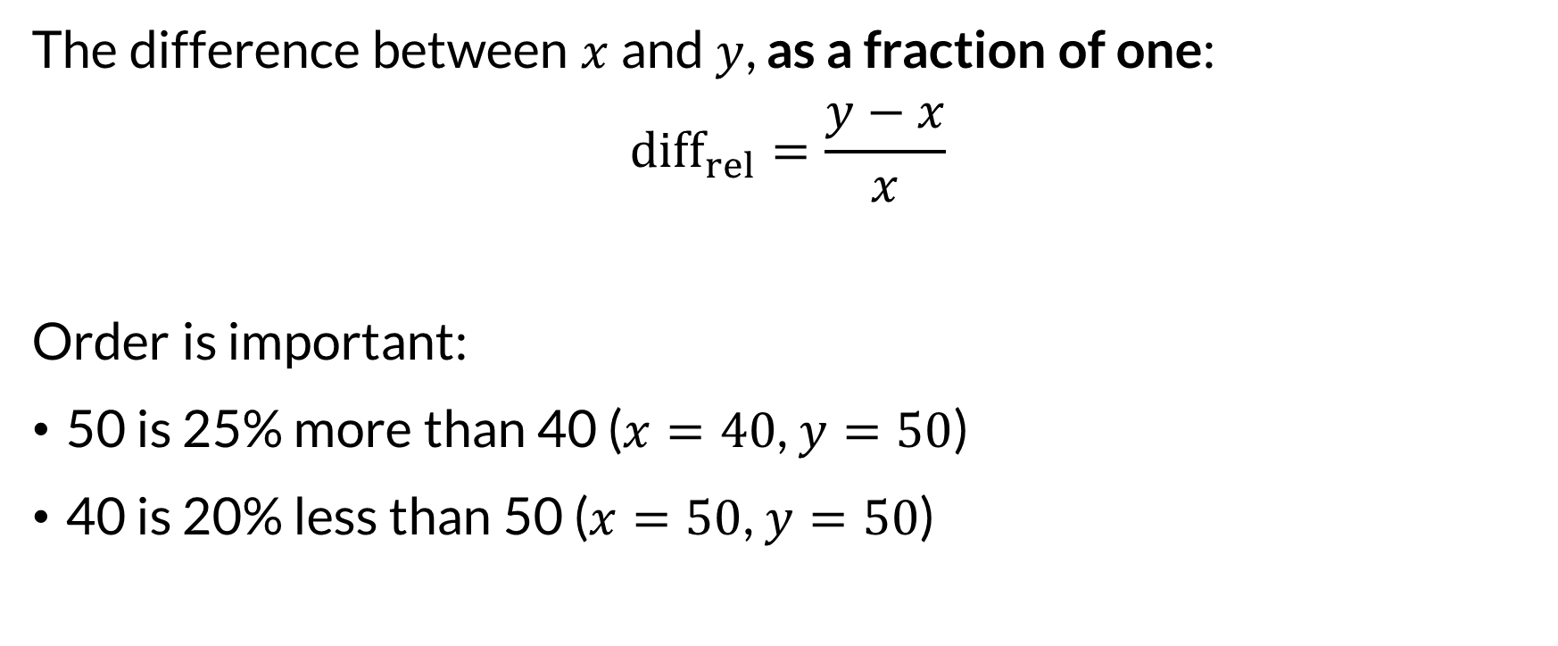
Relative Comparison
The difference between $x$ and $y$, as a fraction of one:
$${diff}_{rel}=\frac{y−x}{x}$$
Order is important:
50 is 25% more than 40 ($x=40$, $y=50$)
40 is 20% less than 50 ($x=50$, $y=50$)

Slide 8
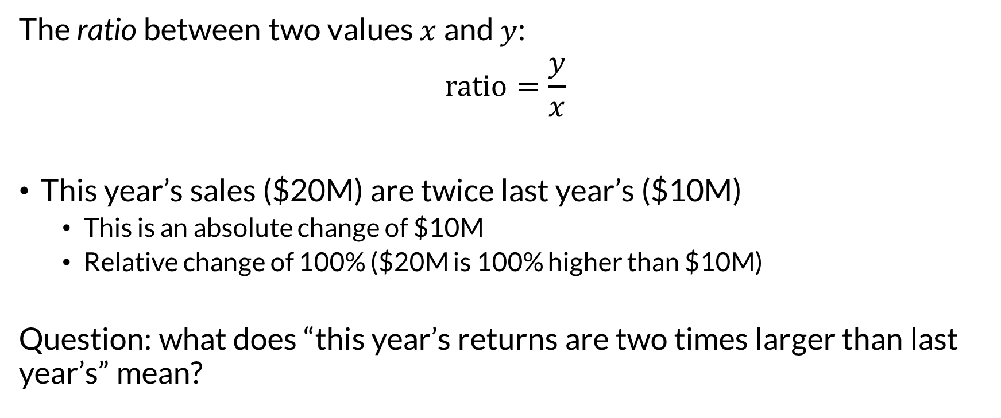
Ratio Comparison
The ratio between two values $x$ and $y$:
$$ratio=\frac{y}{x}$$
This year’s sales ($20M) are twice last year’s ($10M)
This is an absolute change of $10M
Relative change of 100% ($20M is 100% higher than $10M)
Question: what does “this year’s returns are two times larger than last year’s” mean?

Slide 9
Appropriate Comparison
Depends on context and problem.
Netflix paid $1M to the team that beat its movie recommender by 10% on their chosen metric

Slide 10
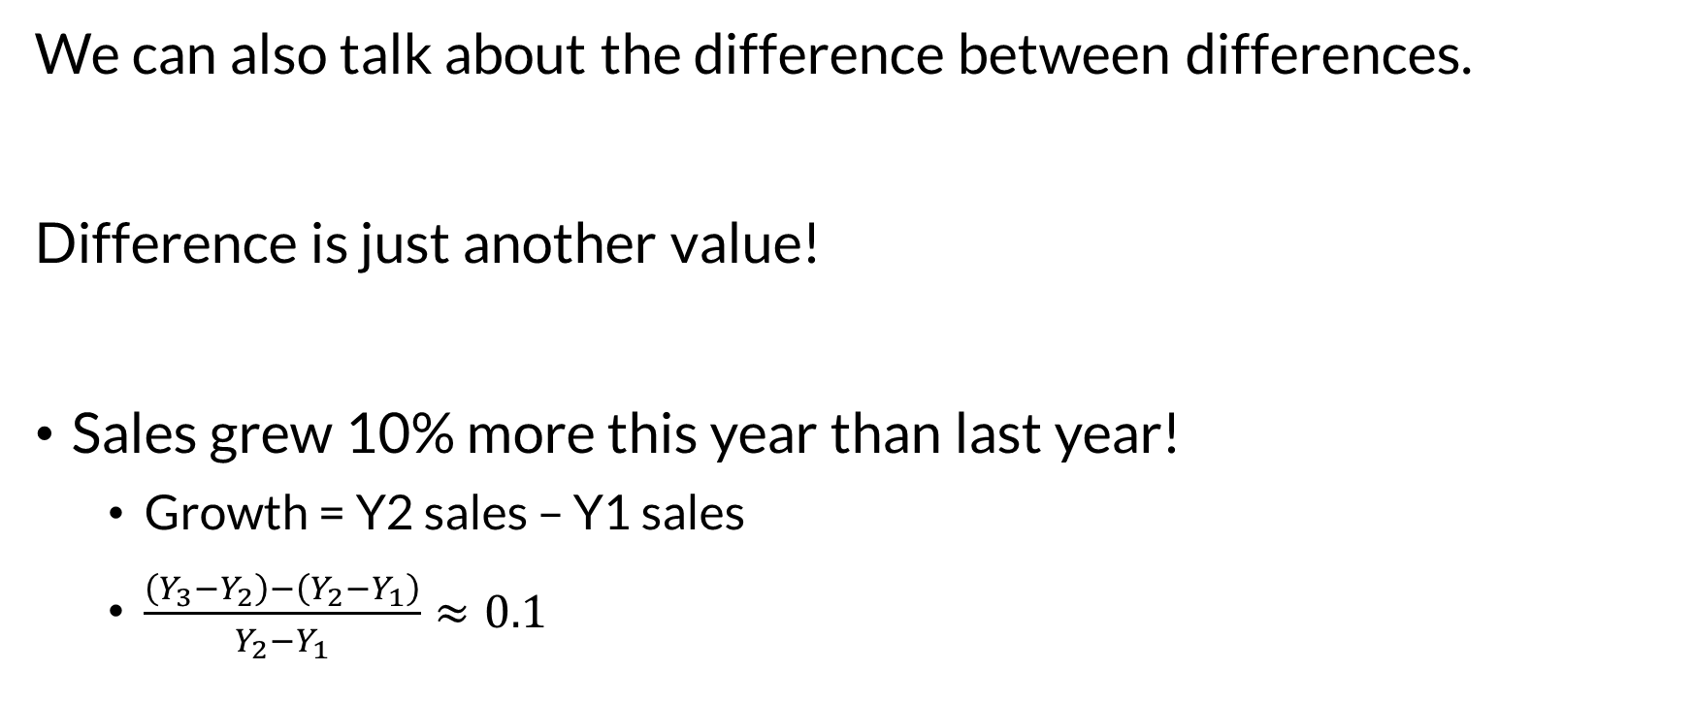
Difference-in-difference
We can also talk about the difference between differences.
Difference is just another value!
Sales grew 10% more this year than last year!
Growth = Y2 sales – Y1 sales
$\frac{\left(Y_{3}−Y_{2}\right)−\left(Y_{2}−Y_{1}\right)}{Y_{2}−Y_{1}}≈0.1$

Slide 11
Visual Comparison
Bar charts emphasize relative difference
Point plots emphasize absolute difference
Also relative difference-in-difference

Slide 12

Wrapping Up
There are three primary ways to compare statistics: absolute, relative, and ratio.
Be clear and unambiguous when writing the results of a comparison.
Seek to accurately understand others’ writing.
Photo by Nick Fewings on Unsplash

